Slide 1
Complex, Indirect, Convoluted Tasks Yield Better Job Performance
Delivered by: Aaron Makin

Slide 2
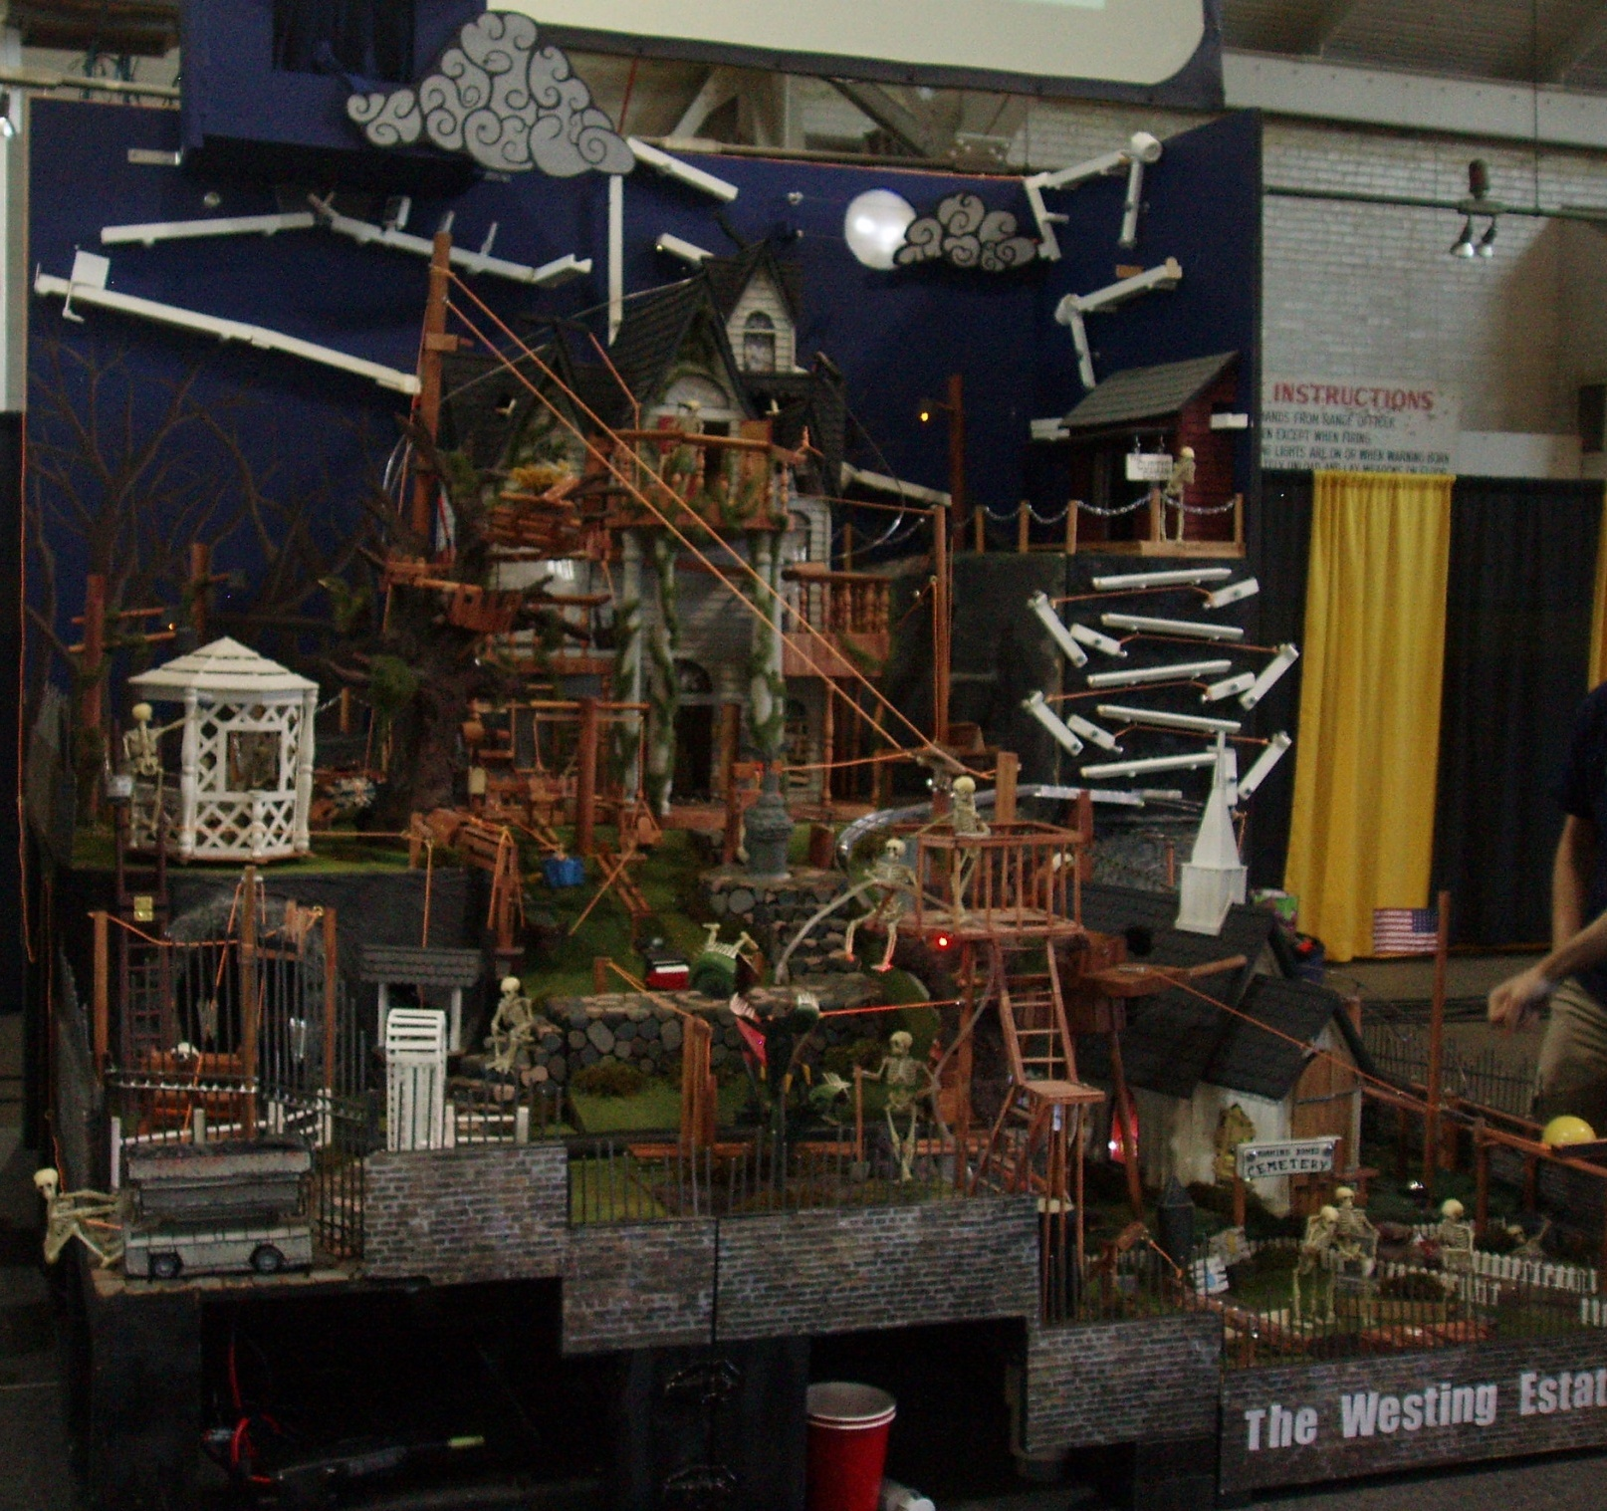

Slide 3
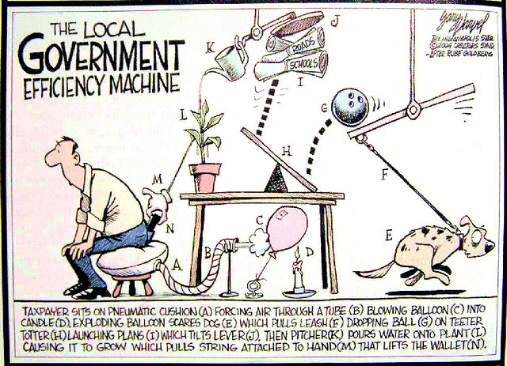
Stephen VanDyke,“The Local government efficiency Machine”, Feb 7, 2006 via Flickr, Creative Commons Attribution

Slide 4
Kindle Creative Thinking

Slide 5
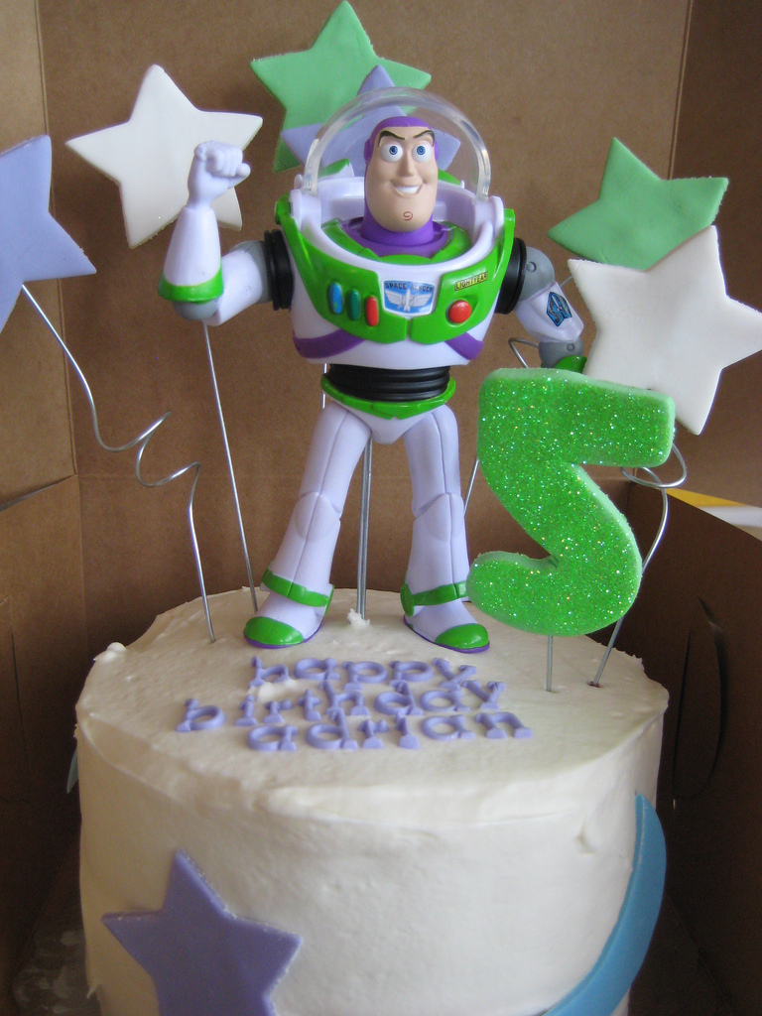
Build to a Theme!
To Infinity and Beyond!
Creative Thinking

Slide 6
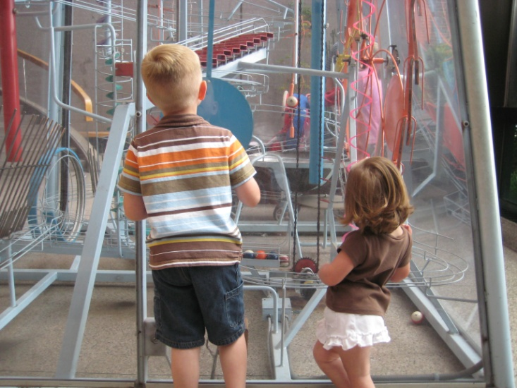
Be Inspired by
Your Environment and Others
Creative Thinking

Slide 7
There are no bad ideas,
just better ones.
Creative Thinking

Slide 8
“Don’t let fear control you,
you control it.”
- Base Jumpers
Creative Thinking

Slide 9
Think of 3 Ways
Creative Thinking

Slide 10
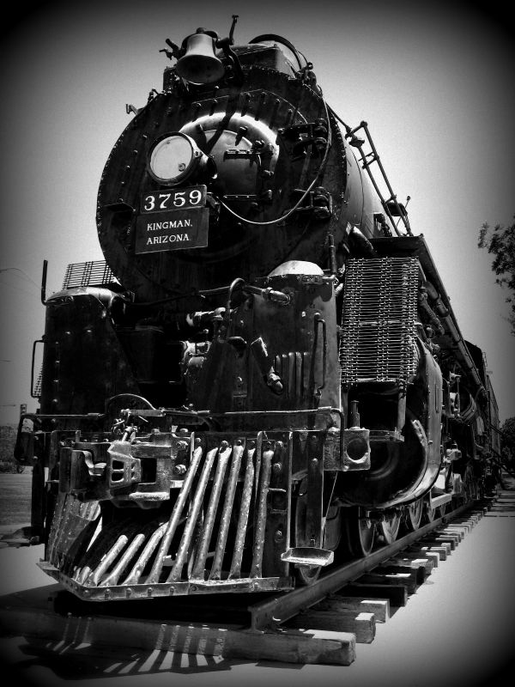
Build Momentum

Slide 11
Start with
Something Small
Build Momentum

Slide 12
Rapid Prototype
Get the ball rolling!
Build Momentum

Slide 13
Confidence = Competitive Advantage
Build Momentum

Slide 14
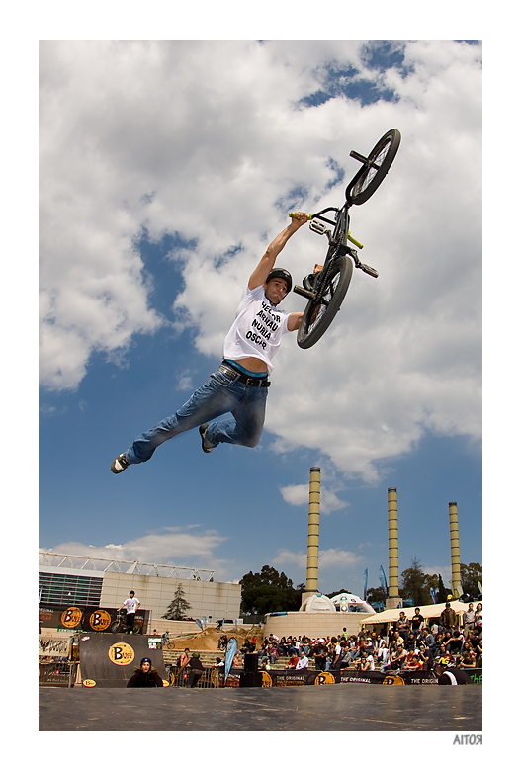
Test Your Abilities

Slide 15
See the Problem
2 heads are better than 1
Small, Controlled Changes
Test Your Abilities

Slide 16
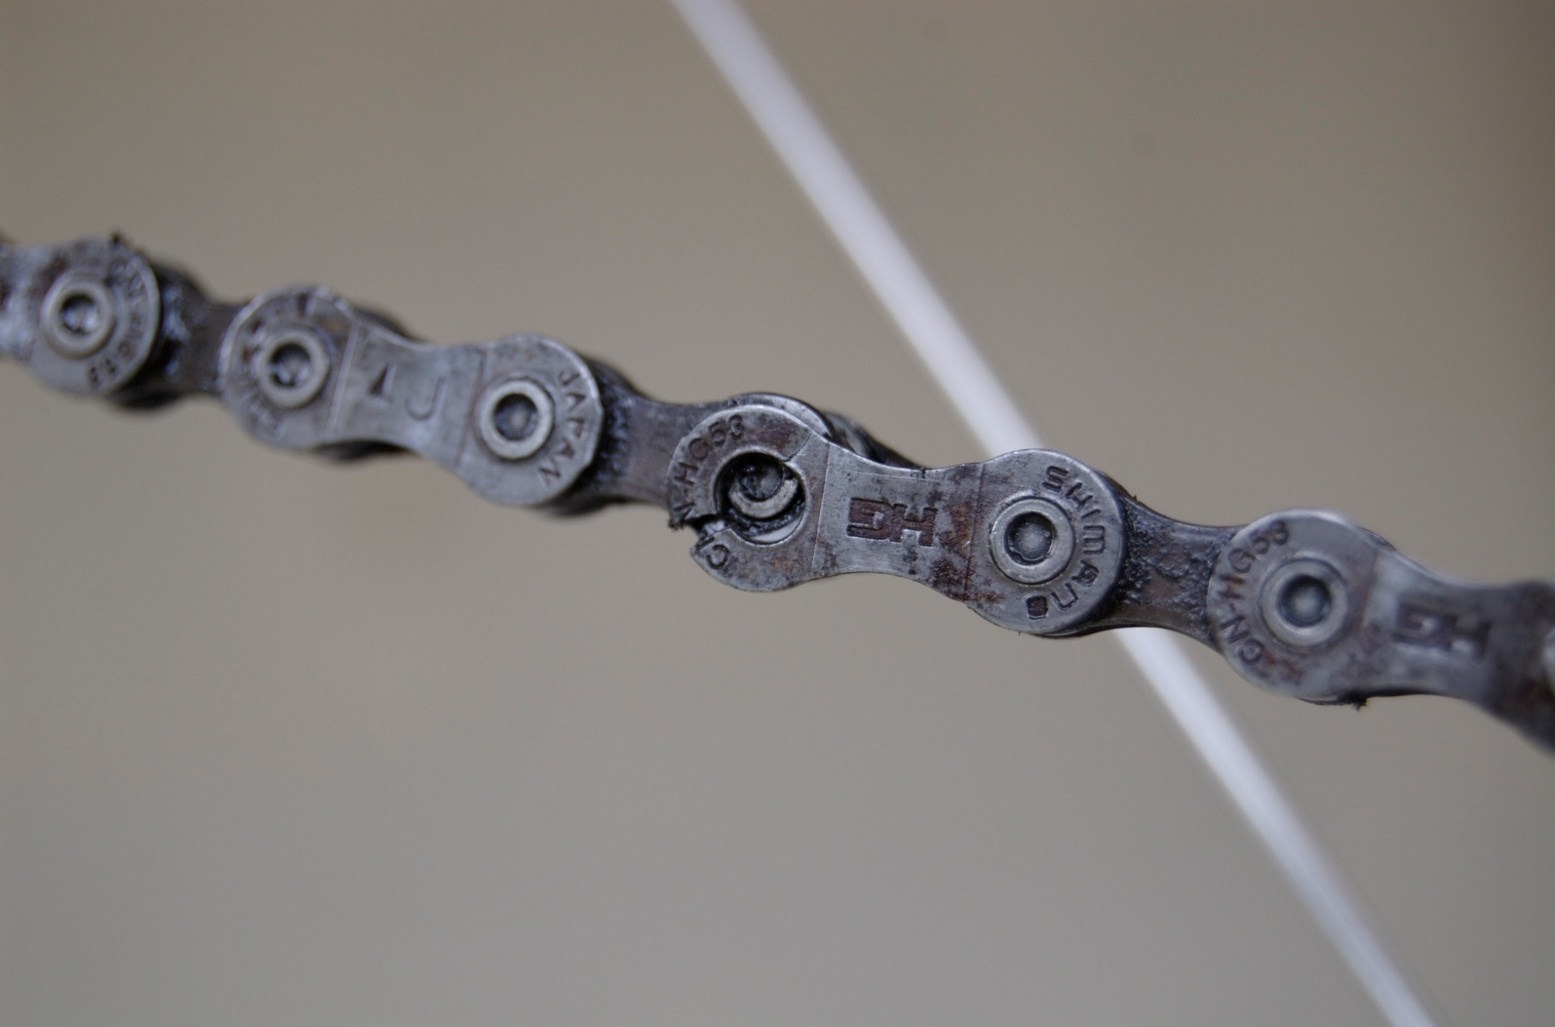
Learn Where Weaknesses Exist
There it is!
Chris Scott, “Broken Chain”, April 28, 2007 via Flickr, Creative Commons Attribution and Share Alike
Test Your Abilities

Slide 17
Igniting
Passion

Slide 18
Fulfillment
Excitement!
Igniting
Passion

Slide 19
Fuel You Forward
Innovation can be seen as something that does, not something that is
- Wiki

Slide 20
Link Together!
IDEA
IDEA
IDEA

